Slide 1


<Dingca>;
Dingca
file
edit
view
C017166 이다경
C011094 백단아

Slide 2
Table of Contents
Dingca
file
edit
view
Project Introduction
Current Progress
Schedule

Slide 3


코딩하는카우
Notes:
딩카 의미
코딩 교육용 앱임을 설명

Slide 4


Dingca
file
edit
view
&
Notes:
개발 도구 소개

Slide 5
Dingca
file
edit
view
Building an application targeting multiple platforms from a single codebase
Notes:
개발 도구 소개

Slide 6
Dingca
file
edit
view
Easily manage various features in the cloud, such as user authentication, database, storage, and analytics
Notes:
개발 도구 소개

Slide 7
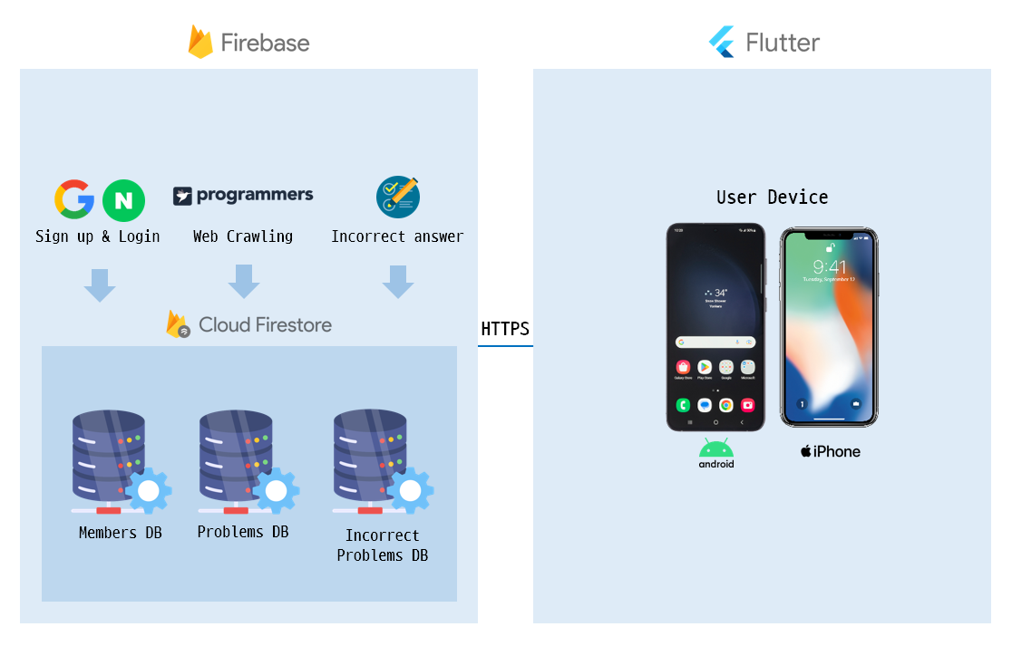
Dingca
file
edit
view
Notes:
시스템 아키텍처

Slide 8
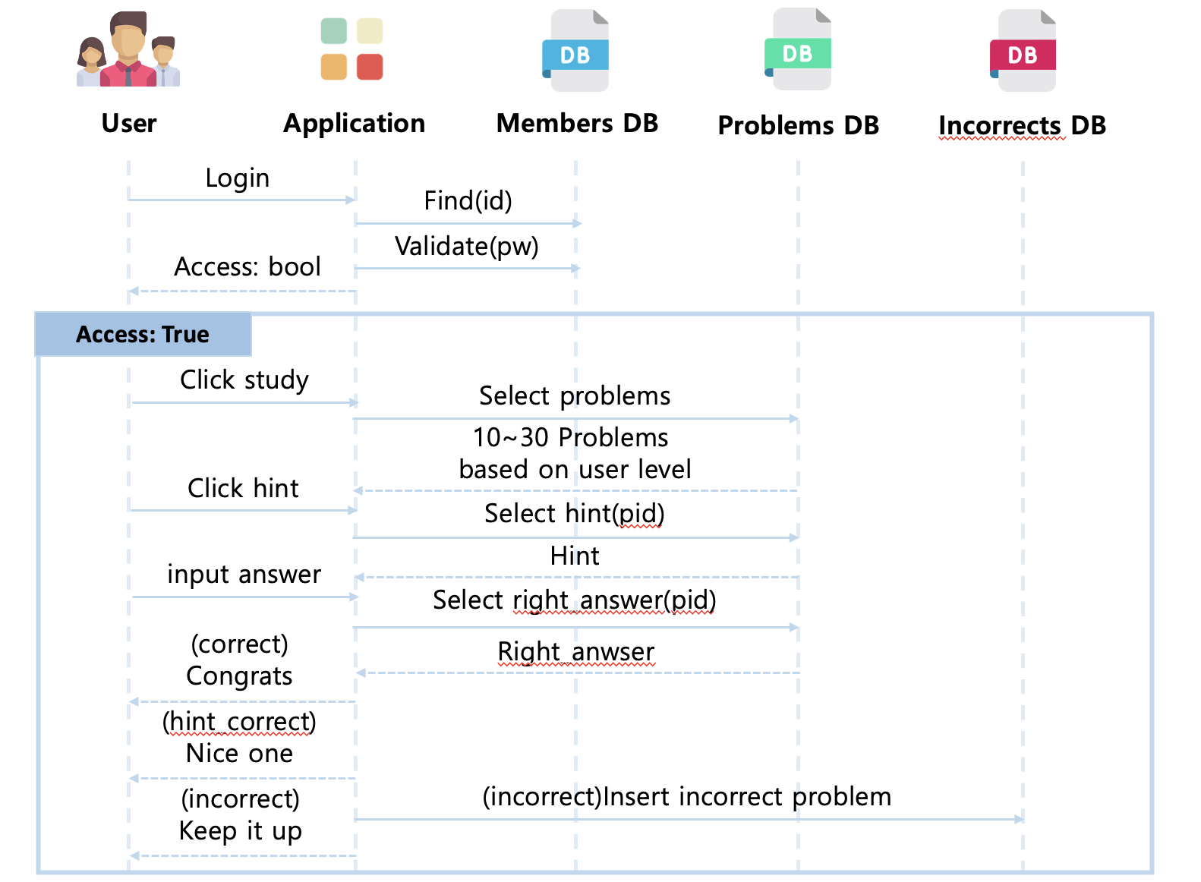
Dingca
file
edit
view
Notes:
시퀀스 다이어그램

Slide 9
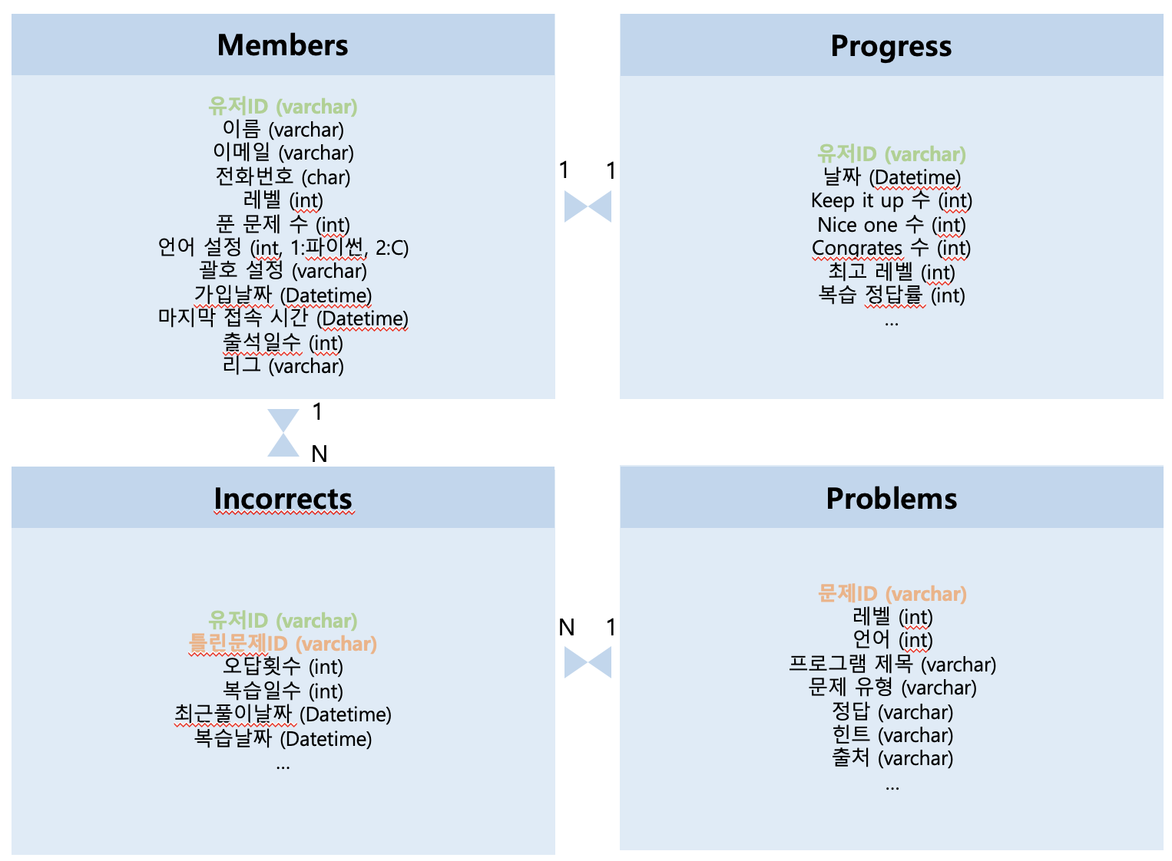
Dingca
file
edit
view
Notes:
데이터베이스 세부

Slide 10
Dingca
file
edit
view
Current Progress
Notes:
앞으로의 일정

Slide 11
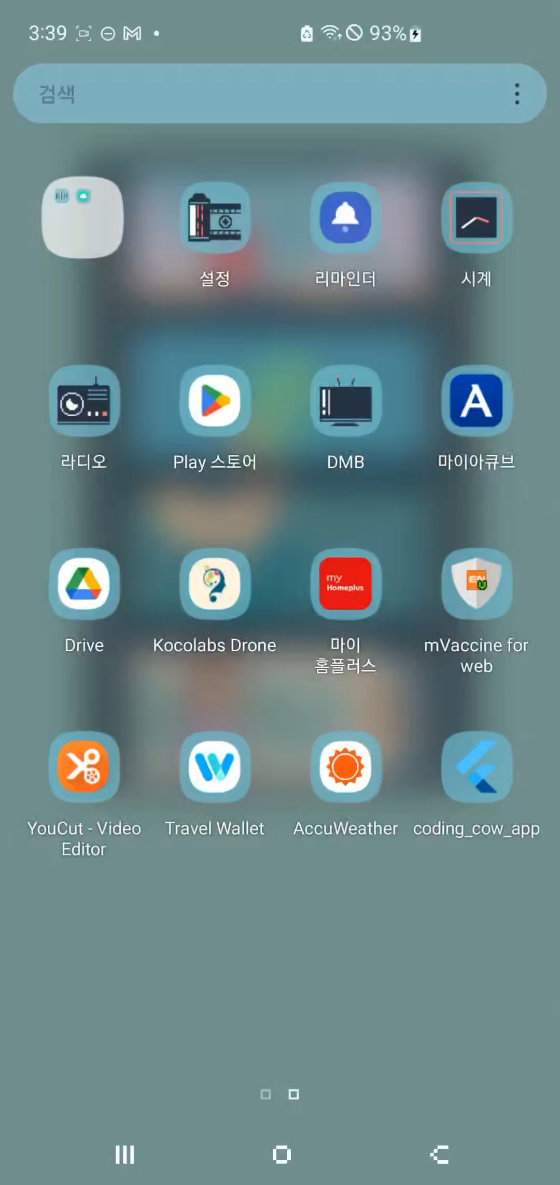
Notes:
앞으로의 일정

Slide 12
Dingca
file
edit
view
Schedule
Notes:
앞으로의 일정

Slide 13
Dingca
file
edit
view
7/1~7/31
Firebase integration
Building a Problem Database(Web Crawling from Programmers)
Building an Incorrect Answer Database
Implementing an Incorrect Answer Note Feature
Notes:
앞으로의 일정

Slide 14
Dingca
file
edit
view
8/1~8/31
Implementing Login Function
Building a User Database
Adding Problem Explanations and Notes Feature
Notes:
앞으로의 일정

Slide 15
Dingca
file
edit
view
9/1~9/30
Building User-specific Statistics Database
Implementing Skill Measurement Feature
Implementing Settings (Language, Parenthesis Position)
Notes:
앞으로의 일정

Slide 16
Dingca
file
edit
view
10/1~10/31
Implementing League/Ranking Feature
Maintenance
Notes:
앞으로의 일정

Slide 17
Dingca
file
edit
view
11/1~
Maintenance and Optimization
Notes:
앞으로의 일정

Slide 18
Dingca
file
edit
view
Q&A

